Slide 1
Topic: Simple Interest EQ: How do we calculate the total amount by using simple interest?
Year 11 Essentials

Slide 2
Things Required For This Lesson
Interactive Notebook
Textbook: Interleaved Maths Essential Connections
Ruler, Red Pen, Pencil, Pens, Scientific Calculator
Growth mindset

Slide 3
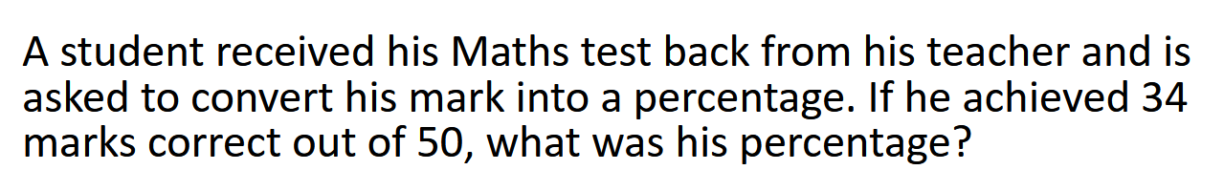
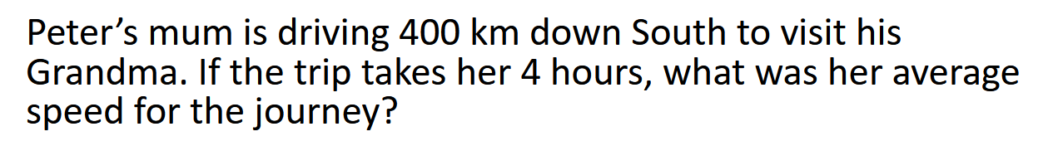
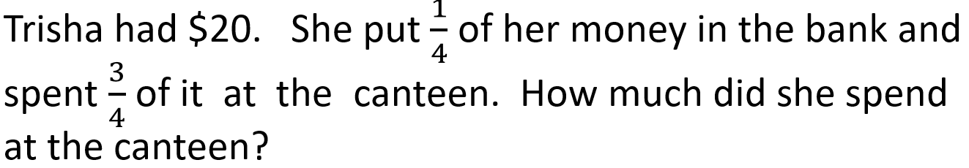
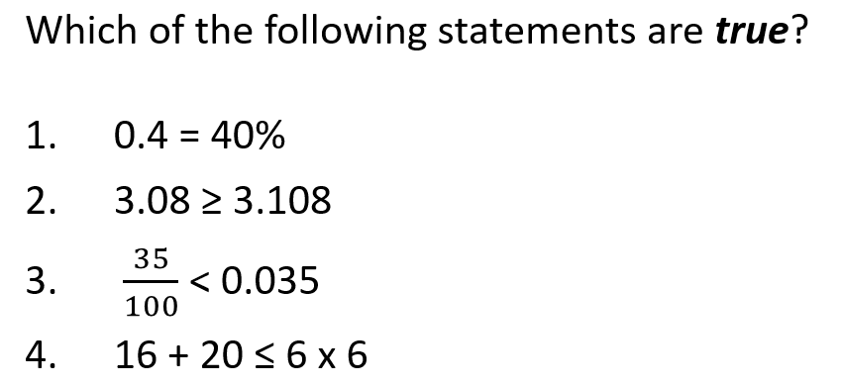
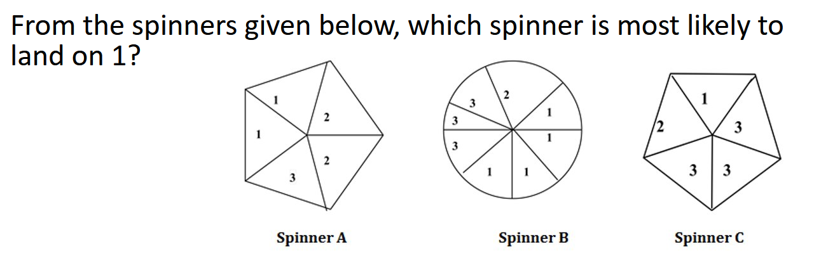
Topic: Simple Interest EQ: How do we calculate the total amount by using simple interest?

Slide 4
Answers
1) 68%
2) 100km/hour
3) $15
4) 1 and 4
5) Spinner B

Slide 5

24
7
30
Topic: Simple Interest
Date: /05/2021
EQ: How do we calculate the total amount by using Simple Interest
WICOR

Slide 6
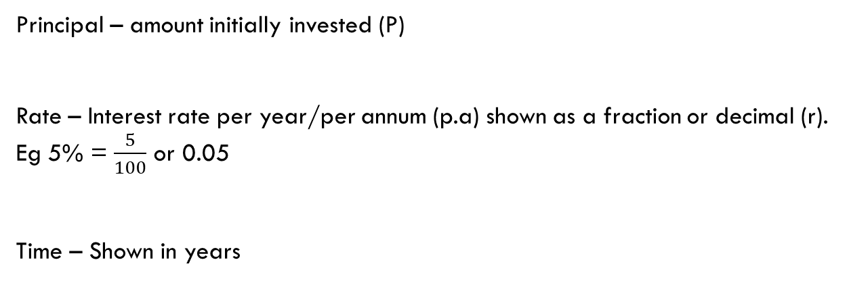
24
7
30
Topic: Simple Interest
EQ: How do we calculate the total amount by using Simple Interest?
What is Simple Interest?
Simple Interest is interest that stays the same each year. It is always calculated on the original amount borrowed or saved.
Principal – amount initially invested (P)
Rate – Interest rate per year/per annum (p.a) shown as a fraction or decimal (r).
Eg 5% = $\frac{5}{100}$ or 0.05
Time – Shown in years
Total amount paid back = Principal + Interest
WICOR

Slide 7
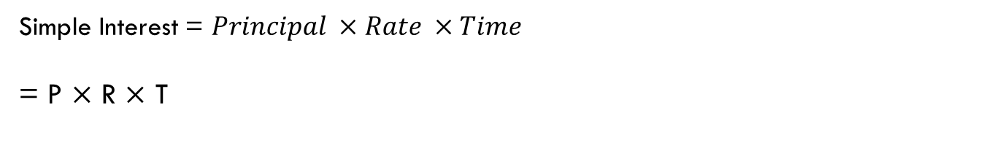
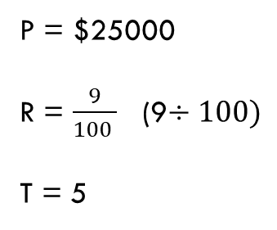
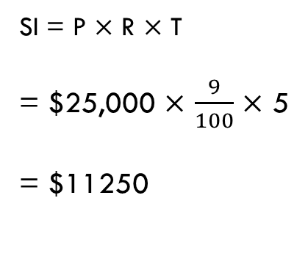
24
7
30
Topic: Simple Interest
EQ: How do we calculate the total amount by using Simple Interest?
What is the formula?
Simple Interest = $Principal ×Rate ×Time$
= P $×$ R $×$ T
Eg1) Calculate Simple Interest charged on a loan of $25000 at 9% p.a for 5 years
SI = P $×$ R $×$ T
= $25,000 $×$ $\frac{9}{100}$ $×$ 5
= $11250
P = $25000
R = $\frac{9}{100 }$ (9$÷100)$
T = 5
WICOR

Slide 8
Experiment (LHS)
If we invested $100 at 10% interest rate for a single year how much do you think we should earn?
What would happen if we invested for 2 years instead? How much interest would we earn instead?

Slide 9
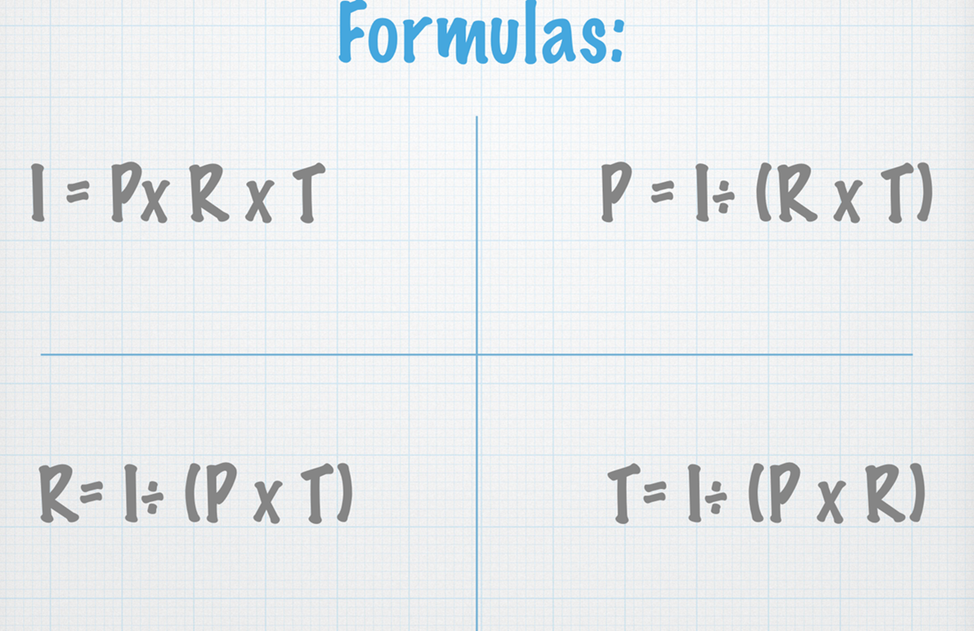
24
7
30
Topic: Simple Interest
EQ: How do we calculate the total amount by using Simple Interest?
What is the formula?
WICOR

Slide 10
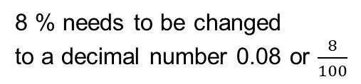
24
7
30
Topic: Principal, Percentage Rate and Time
EQ: How do we calculate the total amount by using Simple Interest?
How do I find the Principal Amount?
If the simple interest on a 3.5 year loan at a rate of 8% pa is $784, what is the principal.
SI = P x R x T
784 = P x 8% x 3.5
8 % needs to be changed
to a decimal number 0.08 or $\frac{8}{100}$
$784 = P x 0.08 x 3.5 (NOTE: 0.08 x 3.5 = 0.28)
$784 = P x 0.28
WICOR
Therefore P = $2800

Slide 11
24
7
30
Topic: Simple Interest
EQ: How do we calculate the total amount by using Simple Interest
How do I find the percentage rate?
If the simple interest on $5400 over two years is $756, what is the interest rate?
SI = P x R x T
$756 = 5400 x R x 2
$756 = 10800 x R
Therefore R as a decimal = 0.07 which means
R as a percentage = 7%
WICOR

Slide 12
24
7
30
Topic: Simple Interest
EQ: How do I apply the Simple Interest formula?
How do I find the time?
How long would it take for $6 200 to accrue $1395 in simple interest at an interest rate of 9% pa?
SI = P x R x T
$1395 = $6200 x 9% x T
$1395= $558 x T (Note: $6200 x 0.09 = $558)
Therefore T = 2.5 years
WICOR

Slide 13
Complete the Table
Principle | Interest (%) | Years | Interest amount
2,500 | 12.5 | 6
40,000 | 5 | 20
150,000 | 6.5 | 13
1,250,000 | 15% | 0.5

Slide 14
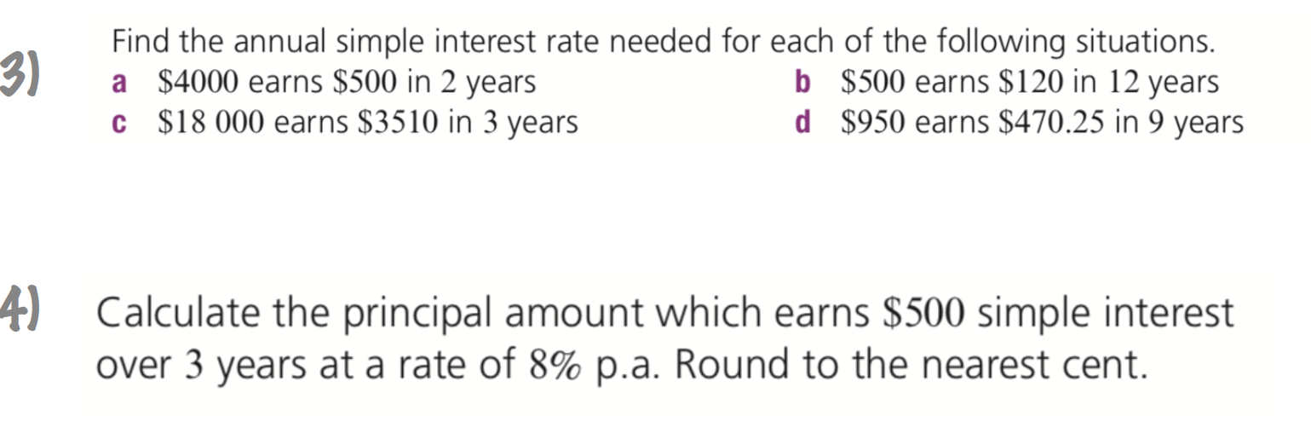
Solve:

Slide 15
Evaluate (LHS)
Use your equation to work out the total amount you would have after the following investments were made.
1. P=$500 r=2.5% t=5 years
2. P=$500 r=4% t=5 years

Slide 16
Extend
Go to page 54 of your Interleave Book and complete the Extend Question

Slide 17

Thank you
Keep up the good work!
“All our dreams can come true if we have the courage to pursue them.”

